Slide 1

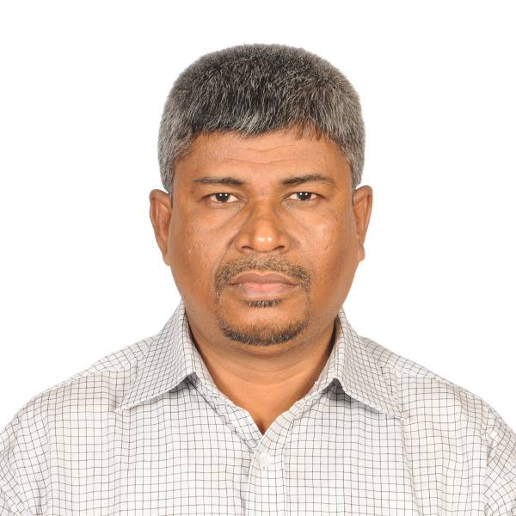
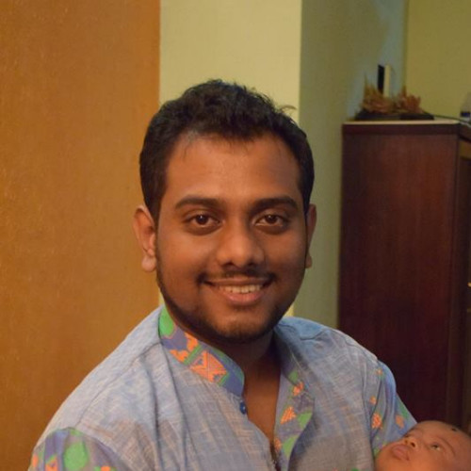
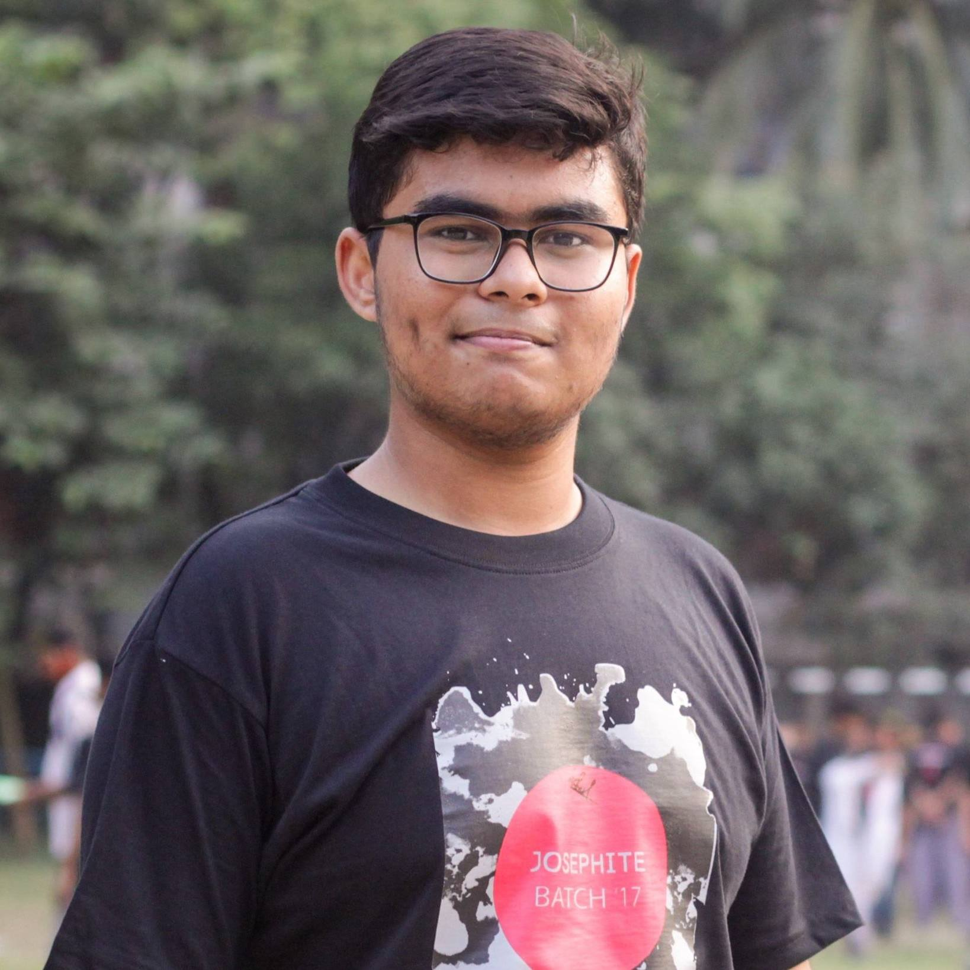
Software Application on Blood Donation System and Forecasting Blood Donor
Supervised by
Dr. M.M.A. Hashem
Professor
Department of Computer Science & Engineering
Khulna University of Engineering & Technology, Khulna.
Team Members
Department of Computer Science & Engineering
Khulna University of Engineering & Technology, Khulna.
Towsif Ahamed Labib
1707061
Md Nazrul Islam
1707086

Slide 2

Background
Blood Transfusion unit (BTU) often undetermined about the future stock from the donation request they gets
In case of emergency blood request victims often fails to get help because of unable to reach a donor.

Slide 3
01
02
04
03
05
06
The proposition
ABOUT THE PROJECT
A system for the BTU which can resolve the issue and a Blood donation System
An android application for the BTU and the donors
PROJECT GOALS
MAIN REQUIREMENTS
A Prediction Model for the Donor and blood donation request and donation system.
Android Phone running version 9 or above and internet connection
PROJECT STAGES
OUR TEAM
The project goal is achieved by following a Waterflow Model
Under the supervision of Dr M.M.A. Hashem the project is executed by Towsif Ahmed Labib and Md Nazrul Islam

Slide 4
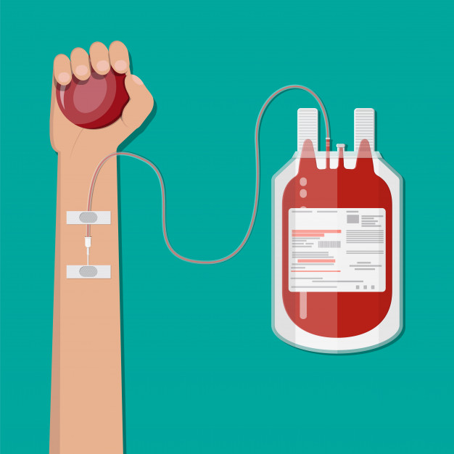
The proposition
Blood donation is voluntary work
The uncertainty in supply, the short shelf life of blood products and voluntary donations becomes the main concern in the blood supply chain.
The uncertainty cause the wastes of resources
Many individuals signed up for volunteer blood donations during a blood donation event.
Thus Blood Transfusion Unit(BTU) has to prepare for all possible donor to help them donating blood.

Slide 5
The proposition(cont.)
If the BTUs can forecast the amount of the expected donor before the then it will help them to organize an event with more ease also resolving the wastage of resource.
The ability to predict transfusions arising during hospital admission might enable economized blood supply management and might furthermore increase patient safety by ensuring a sufficient stock.
Mostly in event of an emergency blood request, patients frequently do not receive assistance due to an inability to contact a donor.

Slide 6
The proposition (cont.)
Donating blood is a noble gesture. The majority of individuals want to assist by donating blood, but they are not always aware of an emergency blood need.
Also, if a person is unable to assist a patient through contribution, he or she might assist the sufferer by sharing the news of emergency.
In an emergency, having a platform where a sufferer may request blood is quite beneficial.

Slide 7

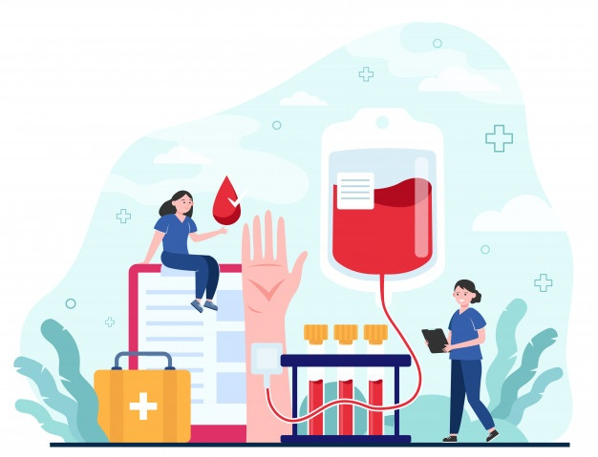
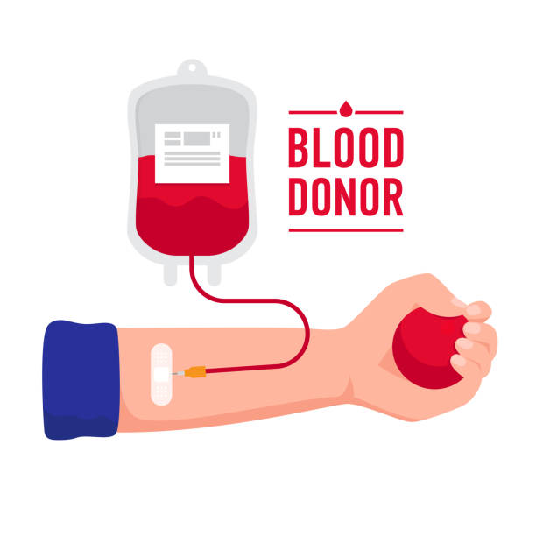

WHAT WE ARE WORKING ON
For btu
Emergency blood request
Making a predictor model to forecast the number of expected donor in an event from the register data by analyzing the previous records.
A platform where a person will able to request for emergency blood request.
donor
Blood supply chain
A platform where volunteer donor will able to check for emergency blood request.
Creating an environment where the donor and the emergency blood requester have a communication.

Slide 8
ABOUT THE PROJECT
For solving the issues discussed previously an android application has been created that can perform the all the features.

Slide 9
An Android application
Overview

Slide 10
features
Here is the list of the features which have been implemented in the application.
A predictor model which runs on cloud for the organization member to forecast the possible number of the donors whom are expected to donate blood. This feature is only able to access by the organization members only.
The application is also able to use by the users to sign up for voluntary blood donations and can keep track of his blood donation history.
The application can also be used by the user to request for blood donation if any emergency case. To do so the user has to create an account.
The application is implemented with OSM which is an open-source map service to fetch and show location information.

Slide 11
features
Here is the list of the features which have been implemented in the application.
This application is implemented with an interactive notification system for the donors where they will find out the emergency case that happens near his/her location if he can donate blood.
If one user accepts any emergency blood request then the notification will be automatically removed from the other users.
A spam detection system is been added to the application if any users want to spam the application by requesting blood again and again.

Slide 12
Technical features
Technical requirement and features of the application.
The application needs minimum SDK of 28 to run.
Must give the permission to access the storage and location to run the application.
Must have a touch screen input to run the application
Must have the internet connection to use the features of the application
Must have a GPS sensor
Must have a 64bit architecture processor

Slide 13
GUI Design
Graphical Design of the Implemented Application

Slide 14
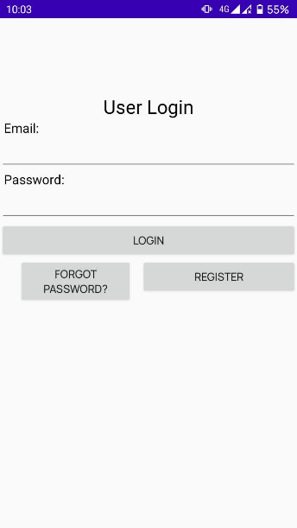
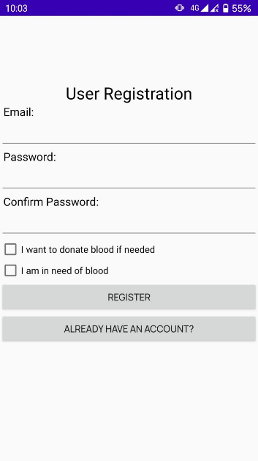

Graphical User Interface
User Login Page
User Registration Page
Requires email and password to log in
Requires email and password to register

Slide 15
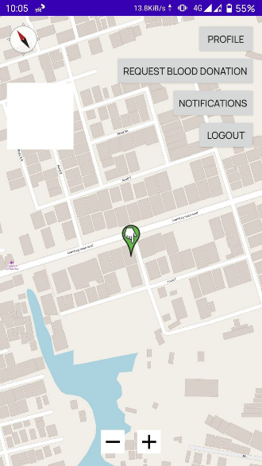
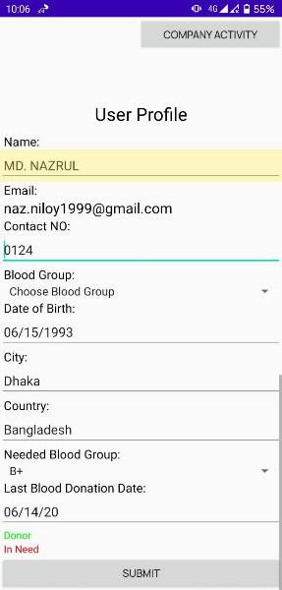
Graphical User Interface
Home Page
User Profile page
Use of OSM for fetching and showing location of donor and requester.
User Profile Page which shows the information of the User Data

Slide 16
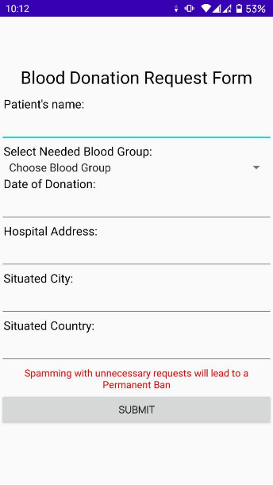
Graphical User Interface
Blood Request Form
This is a blood requested form where one can able to request for blood donation in case of emergency and the record will be circulated to the nearby volunteer phone as an interactive notification.

Slide 17
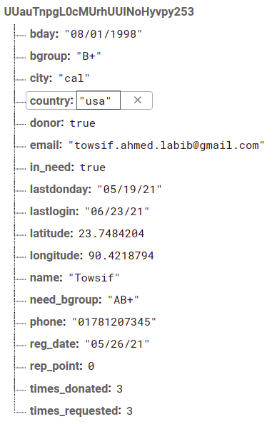
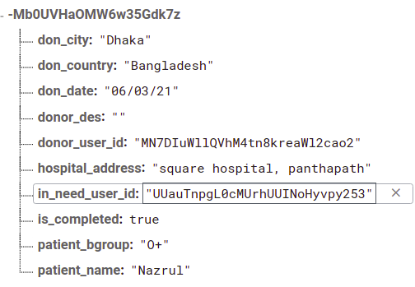
Firebase Database
Sample User Data
Sample Form Data

Slide 18
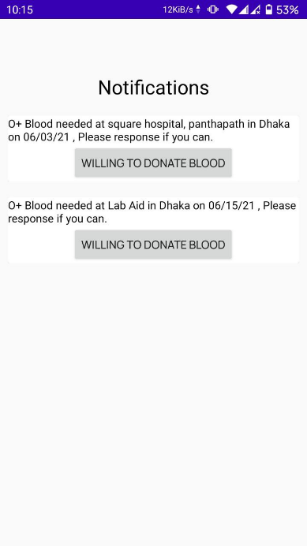
Graphical User Interface
Notification Center
When any one request for the blood a notification will be send to the all the nearby donor. If someone responds to some notification then the notification will be get deleted from the other application user. Thus, the notification of the application will not create any bloat.

Slide 19
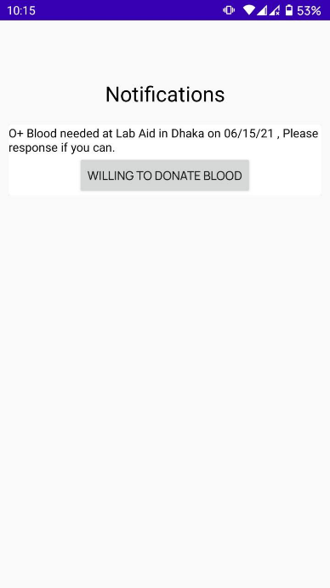
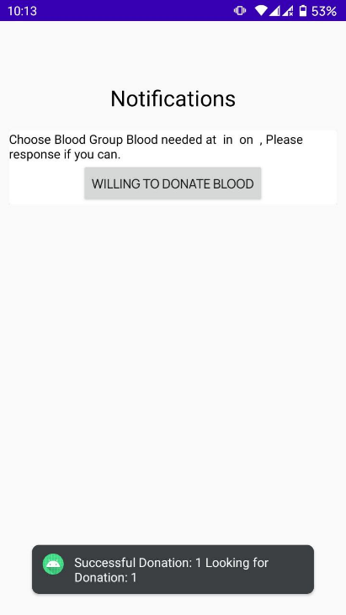
Graphical User Interface
Notification Center
Notification Center
Notification arrives
Respond to the Notification

Slide 20
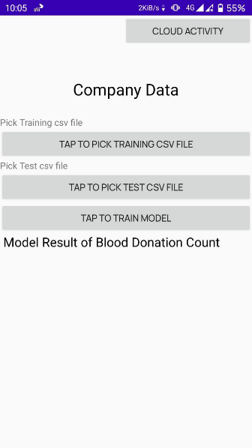
Graphical User Interface
Model run page
Here the BTU authority able to predict the expected donor from the registration data. To do that they have to import the previous record of the donor registration data and blood donation success and forecast the expected blood donor before an event.

Slide 21
Key features
Summary

Slide 22
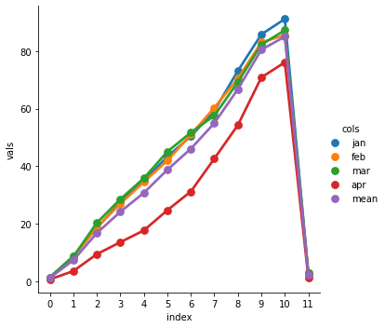
A Decision tree based regressor model has been integrated for the prediction
A Decision tree based Forecasting Model

Slide 23

The model is run on the cloud to do the heavy calculation and sends the result of the prediction to their devices.
Cloud implementation for the predictor model

Slide 24
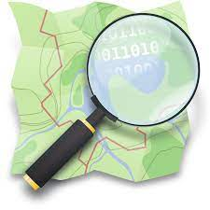
Integration of the Open Source Map Service
OpenStreetMap

Slide 25
Notification 🔔
User authentication and interactive notification system has been implemented which notification will contain the information of the victims.
Address
Interactive notification

Slide 26
Detecting the fake or spam blood donation request based on the request frequency and own algorithm.
Spam detection

Slide 27
Project Management
Project management plan

Slide 28
Lifecycle Model Used
To achieve the goals and a successful implementation of the program a water flow model has been used.
The sequential phases in Waterfall model are
Requirement Gathering and analysis
System Design
Implementation
Integration and Testing
Deployment of system
Maintenance

Slide 29
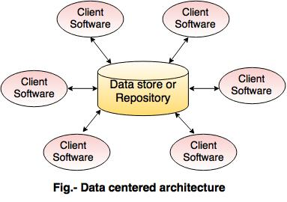
Architecture Style
For the project a Data Centered Architecture has been followed

Slide 30
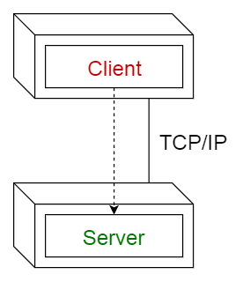
Architectural Pattern
A Client-server pattern based architectural patter has bee used for the application .

Slide 31
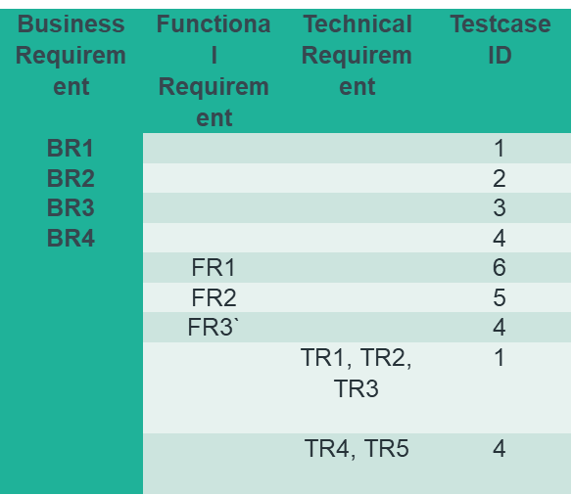
The Test plan
The testing of the application is done with the requirement traceability matrix

Slide 32
Test Plan
Business Requirement
BR# | Module | Application Role | Description
BR1 | Login Logout | Members of the BTU and Users | Member: Member will able to login and will have the access to the Company Activity page User: User will able to see own profile.
BR2 | Forecast Donor number | Members of the BTU | Member of the BTU will able to forecast the possible donor number before an event based on the registration
BR3 | Respond to the Interactive Nonfiction | Users | Users will able to respond the emergency notification
BR4 | Blood Request Form | Users | Users will be able to request for the emergency blood request

Slide 33
Test Plan
Functional Requirement
FR# | Module | Application Role | Description
FR1 | Detect Spam Request | Automatic | If any users tries to spam blood request automatically system will detect
FR2 | Show OSM | Users | User’s current location will be auto sync up
FR3 | Interactive Notification | Users | Show the nearby emergency blood request

Slide 34
Test Plan
TECHNICAL Requirement
TR# | Description
TR1 | Email must not be blanked
TR2 | Password must not be blanked
TR3 | If email and password are valid login
TR4 | Notification will not be sent to a donor if s/he cannot able to donate blood
TR5 | Automatically the notification will be removed if someone respond to it

Slide 35
Test Plan
Traceability of test cases to use cases
Testcase# | BR# | FR# | TR# | Testcase | Test Data | Expected | Remark
1 | BR1 | --- | TR1, TR2, TR3 | Verify Log in | Email=naz.niloy1999@gmail.com Password=123456789 | Successful log in | Success
2 | BR2 | --- | --- | Forecasting | Train Data=January Test Data=February | 47389(with an acc of 99.7) | Success
3 | BR3 | --- | --- | Blood Request Form | User=YY User Group=In need | Submit a blood request Form | Success
4 | BR4 | FR3 | TR4, TR 5 | Interactive Nonfiction | User=XX User Group=Donor User=AA User Group=Donor | See notification of emergency blood request And after responding the notification get removed from everyone | Success
5 |  | FR2 |  | Show OSM | User=XX User Group=Donor | Fetch current location information | Success
6 |  | FR1 |  | Spamming detection | User=ZZ User Group=In Need | The account gets suspended | Success

Slide 36
Test Plan
requirement traceability matrix
Business Requirement | Functional Requirement | Technical Requirement | Testcase ID
BR1 |  |  | 1
BR2 |  |  | 2
BR3 |  |  | 3
BR4 |  |  | 4
 | FR1 |  | 6
 | FR2 |  | 5
 | FR3` |  | 4
 |  | TR1, TR2, TR3 | 1
 |  | TR4, TR5 | 4

Slide 37
Observing the requirement traceability we can see all the requirements to check if the requirements have been fulfilled
All initial requirements fulfilled

Slide 38
Appendix
Here is the list of the additional documents which have been created when making the projects.
The first proposal of the document is here the initial proposal
The requirements analysis here detailed requirement
The use case analysis of the system here developing user case
The report of the project is here project report
The BTU in the presentation refers to the BLOOD TRANSFUSION UNIT
To manage the workflow in the quarantine Notion workspace has been used

Slide 39
OUR TEAM
Supervised by
Dr. M.M.A. Hashem
Professor
Department of Computer Science & Engineering
Khulna University of Engineering & Technology, Khulna.
Team Members
Towsif ahmed Labib
1707061
Md nazrul Islam
1707086
Department of Computer Science & Engineering
Khulna University of Engineering & Technology, Khulna.

Slide 40
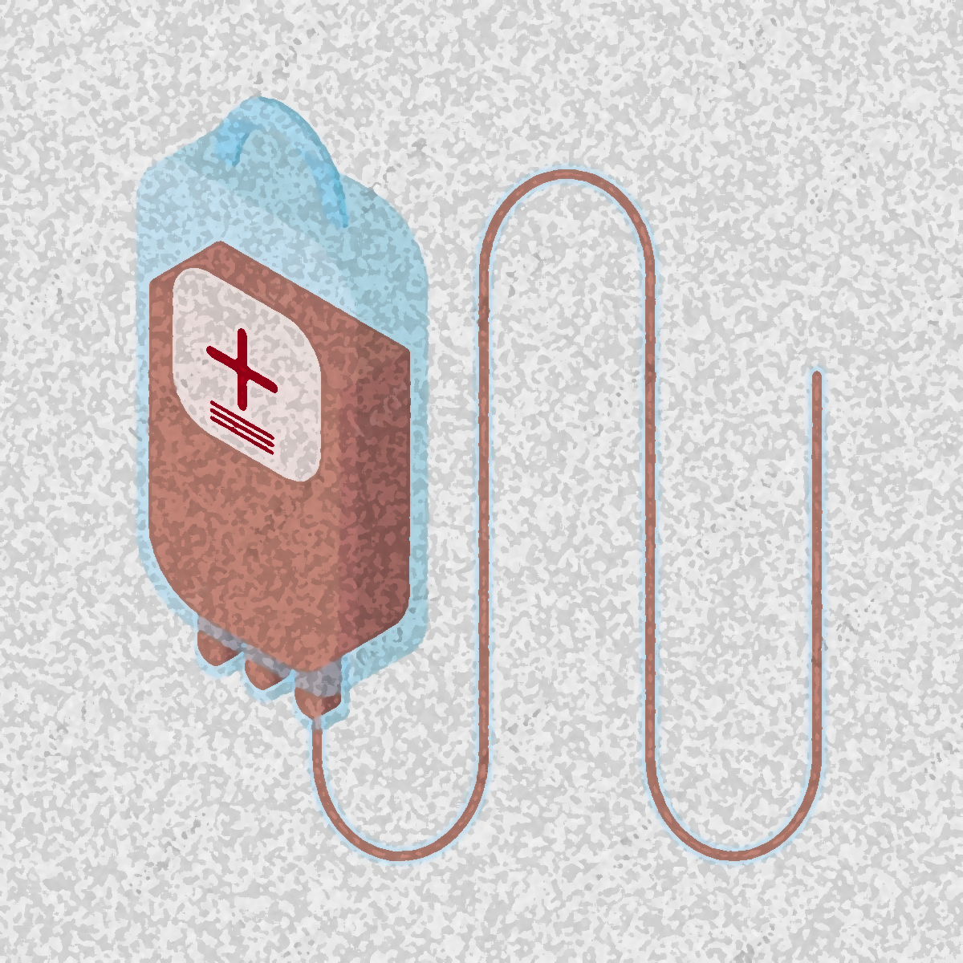
THANKS for your Attention
Does anyone have any thoughts?

